Slide 1
Measuring AlGaAs Electro-optic / Piezoelectric effects (initial results)
Danny Vander-Hyde , Stefan Ballmer, and Steve Penn
May 12, 2020

Slide 2
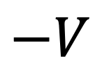
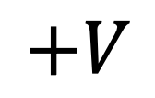
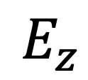
E-field injection concept (basic construction)
$$E_{z}$$
Figure elements do not
reflect realistic scaling
$$+V$$
$$−V$$

Slide 3
Electrode system parameters
Electrode plates:
Aperture diameter : 3 mm
Plates diameter : 76.2 mm
Plate separation : 9 mm
Voltage across electrodes : 300 V
Optic:
Optic diameter : 25.4 mm
Optic thickness : 7 mm
Material : Fused silica
Amorphous coating mirror
SiO₂ /Ta₂O₅
AlGaAs mirror

Slide 4
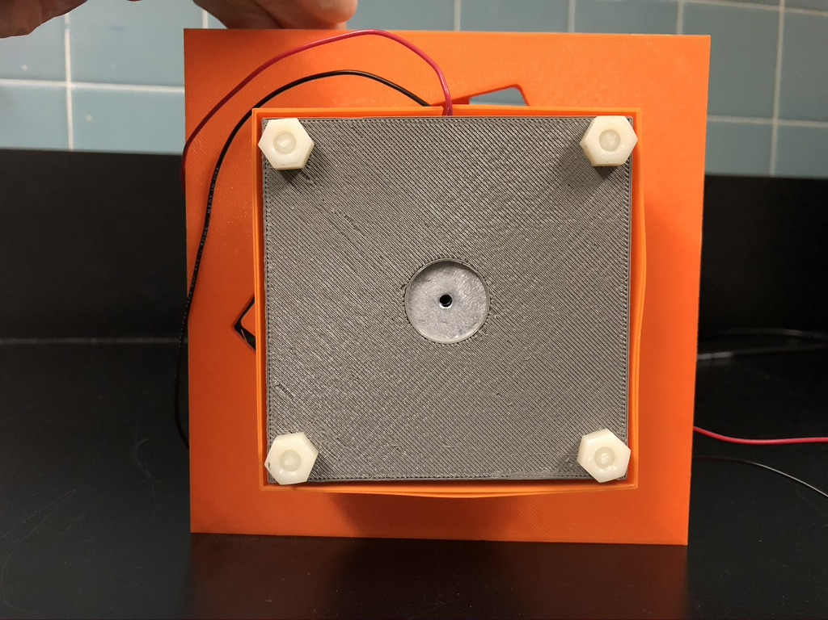
3D printed enclosure / optic mount

Slide 5
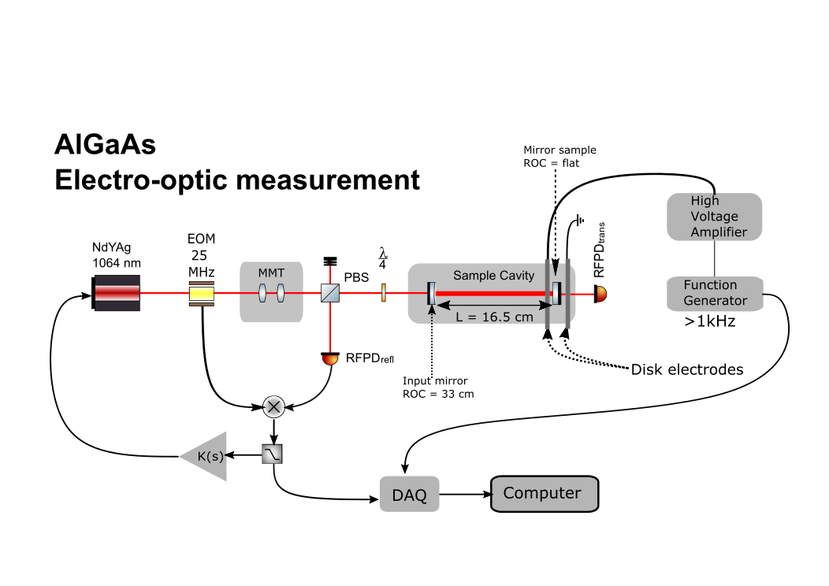

Slide 6
Initial results (04-26-2020)

Slide 7
The Model

Slide 8
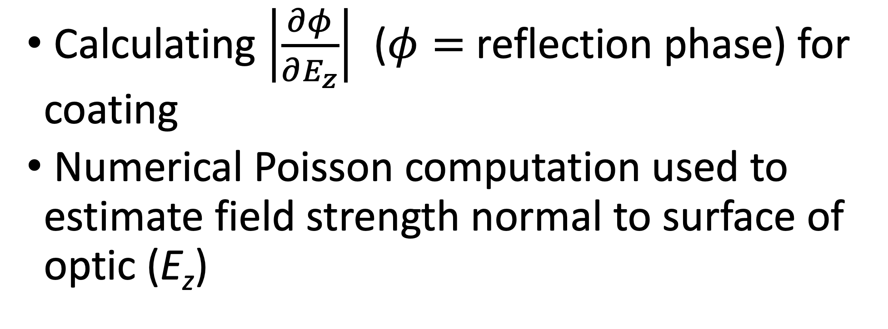
Where does this model estimate come from?
Calculating $\left|\frac{∂φ}{∂E_{z}}\right|$ ($φ=$reflection phase) for coating
Numerical Poisson computation used to estimate field strength normal to surface of optic (E_{z})

Slide 9
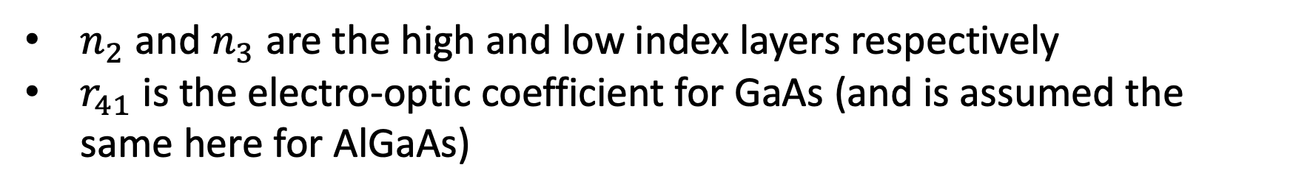
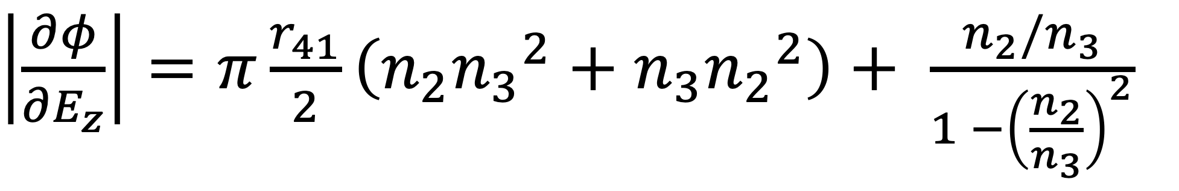
Electro-optic effect estimate
Treatment analogous to thermo-optic effect
Temperature coefficient ➔ electro-optic coefficient
Assume incident light is polarized along the [110] crystallographic direction
$\left|\frac{∂φ}{{∂E}_{z}}\right|=π\frac{r_{41}}{2}\left(n_{2}{n_{3}}^{2}+n_{3}{n_{2}}^{2}\right)+ \frac{n_{2}/n_{3}}{1 −{\left(\frac{n_{2}}{n_{3}}\right)}^{2}}$
$n_{2}$ and $n_{3}$ are the high and low index layers respectively
$r_{41}$ is the electro-optic coefficient for GaAs (and is assumed the same here for AlGaAs)

Slide 10
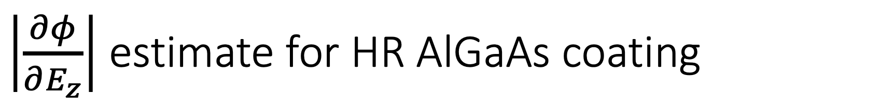
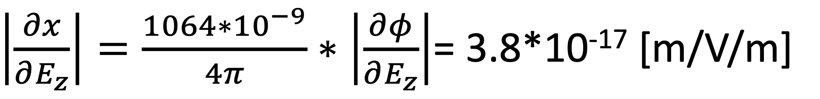
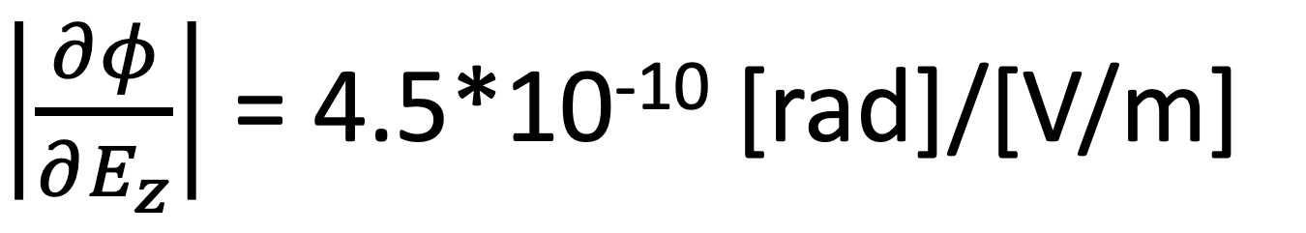
$\left|\frac{∂φ}{∂E_{z}}\right|$ estimate for HR AlGaAs coating
$\left|\frac{∂φ}{∂E_{z}}\right|$ = 4.5*10⁻¹⁰ [rad]/[V/m]
$\left|\frac{∂x}{∂E_{z}}\right|=\frac{1064∗{10}^{−9}}{4π}∗\left|\frac{∂φ}{∂E_{z}}\right|$= 3.8*10⁻¹⁷ [m/V/m]
Notes:
2 pi / half fringe (or 2pi of phase shift in reflection per half wavelength)

Slide 11
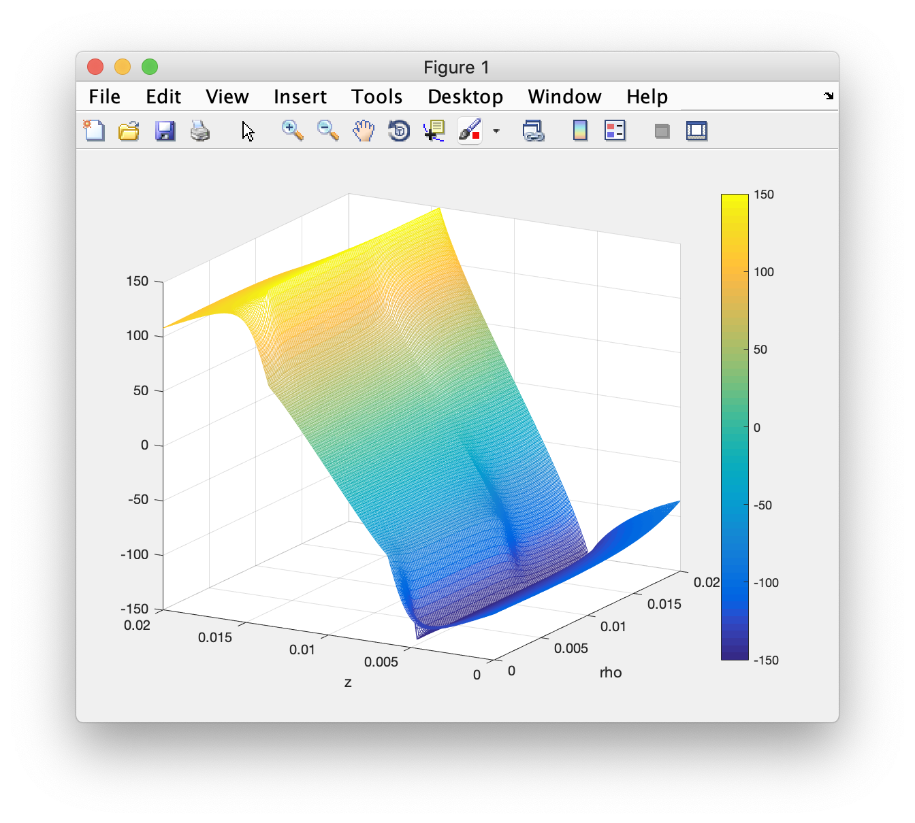
Numerical Poisson calculator results (potential map)

Slide 12
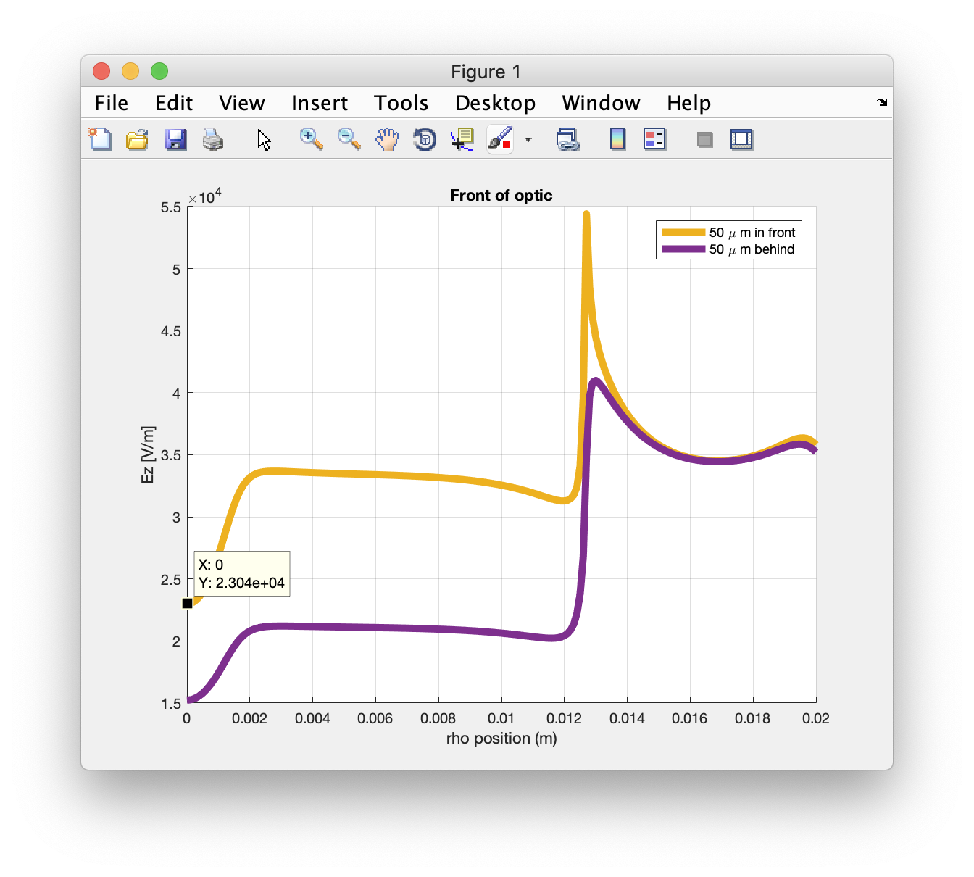
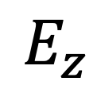
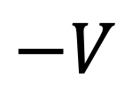


Numerical Poisson calculator results (Ez outside)
$$E_{z}$$
$$+V$$
Slightly outside optic media
($50 μm from front face)$
$$−V$$
Notes:
Change wording here so it isjust outside and inside

Slide 13
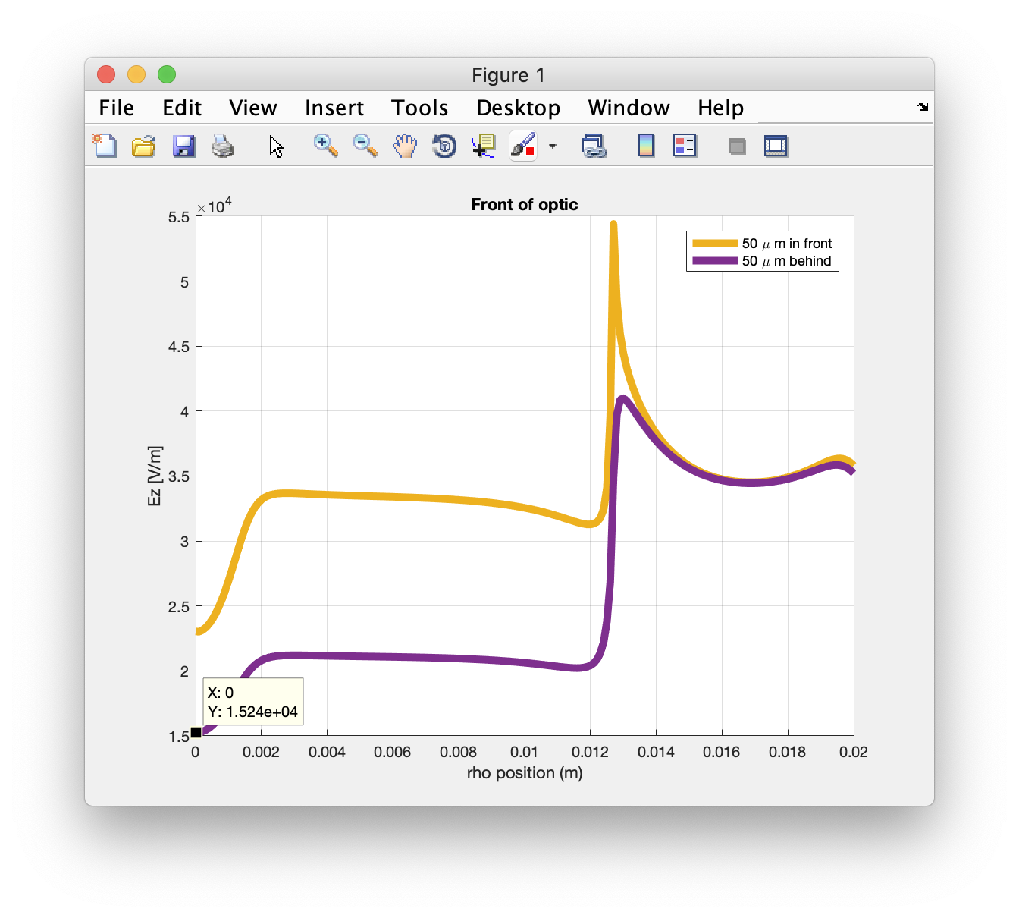

Numerical Poisson calculator results (Ez inside)
$$E_{z}$$
$$+V$$
$$−V$$
Slightly inside optic media
($50 μm$ behind front face)
Notes:
Change wording here so it is just outside and inside

Slide 14
The Measurements

Slide 15
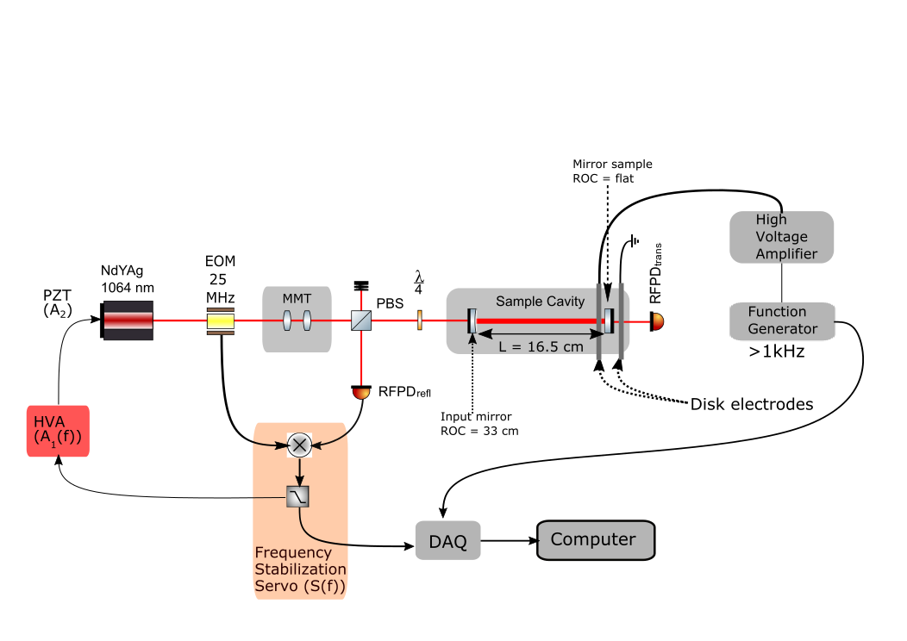
Servo loop
V_{out} (f)
Notes:
Fixed polarization orientation, am looking to add a rotation feature in mount to sample different optic orientations.
Did not explicitly measure A2 but the calibration factor shows very deviation beyond unity across all measured frequencies hence we assume a DC value of A2 based on the laser spec sheets will suffice until A2 is explicitly measured with a cavity sweep
Input mirror T = 578.5 ppm
Amorphous coating end mirror T = 593.2 ppm
AlGaAs mirror T = 39.9 ppm
Difference in Finesse between the two cavities:
Amorphous coating end mirror cav : 5.37e3
AlGaAs mirror cav : 10.2e3

Slide 16
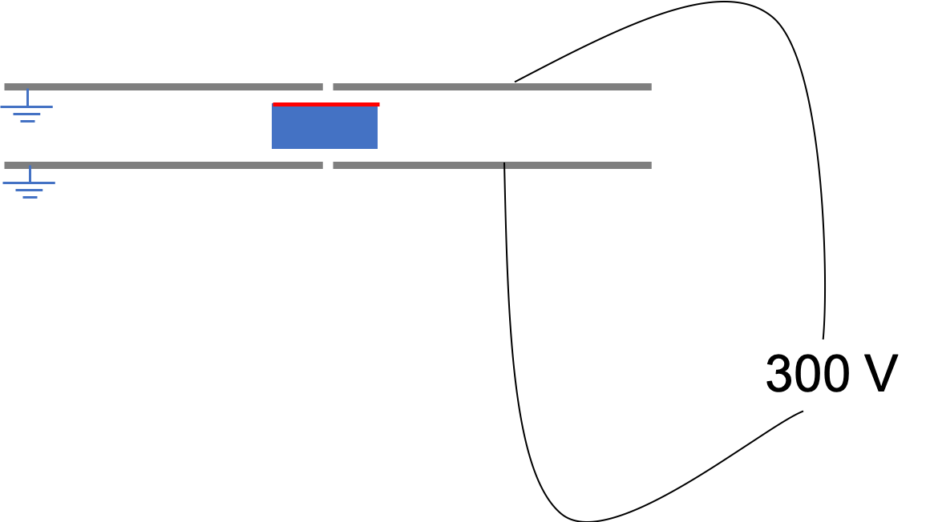
Next measurements
Frequency sweep measurement from 300 Hz to 5 kHz
Harmonics measurement
Sample different mirror end mirror rotations to sample different polarizations
Measure dn/dE + dL/dE effects for controlled non-normal fields
Alternative split electrode design
Notes:
300 when signal disappears in noise
Suspected laser pzt resonances

Slide 17
Questions?

Slide 18
References
Fejer, M.M. , Electro-optic Effects in AlGaAs mirrors , (2018)
Cahillane, C., Initial Electric Field Meter Results For Advanced LIGO and Beyond, (2018)

Slide 19
Extra Slides (Some transfer function measurements and sanity checks)

Slide 20

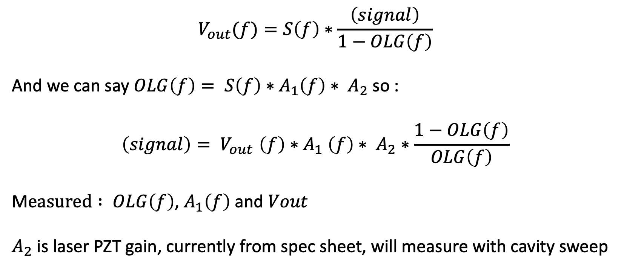
What the DAQ sees at V$out$
$$V_{out}(f)=S\left(f\right)∗\frac{\left(signal\right)}{1−OLG\left(f\right)}$$
And we can say $OLG\left(f\right)= S\left(f\right)∗A_{1}\left(f\right)∗ A_{2}$ so :
$$\left(signal\right){= V}_{out}\left(f\right){∗A}_{1}\left(f\right)∗ A_{2}∗\frac{1−OLG\left(f\right)}{OLG\left(f\right)}$$
M$easured : OLG\left(f\right)$, $A_{1}\left(f\right)$and $Vout$
$A_{2}$ is laser PZT gain, currently from spec sheet, will measure with cavity sweep

Slide 21
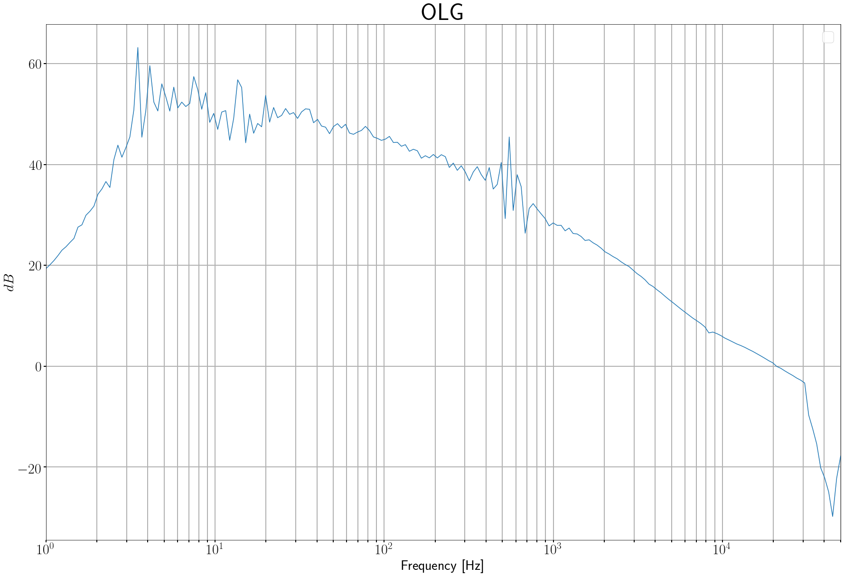

Slide 22
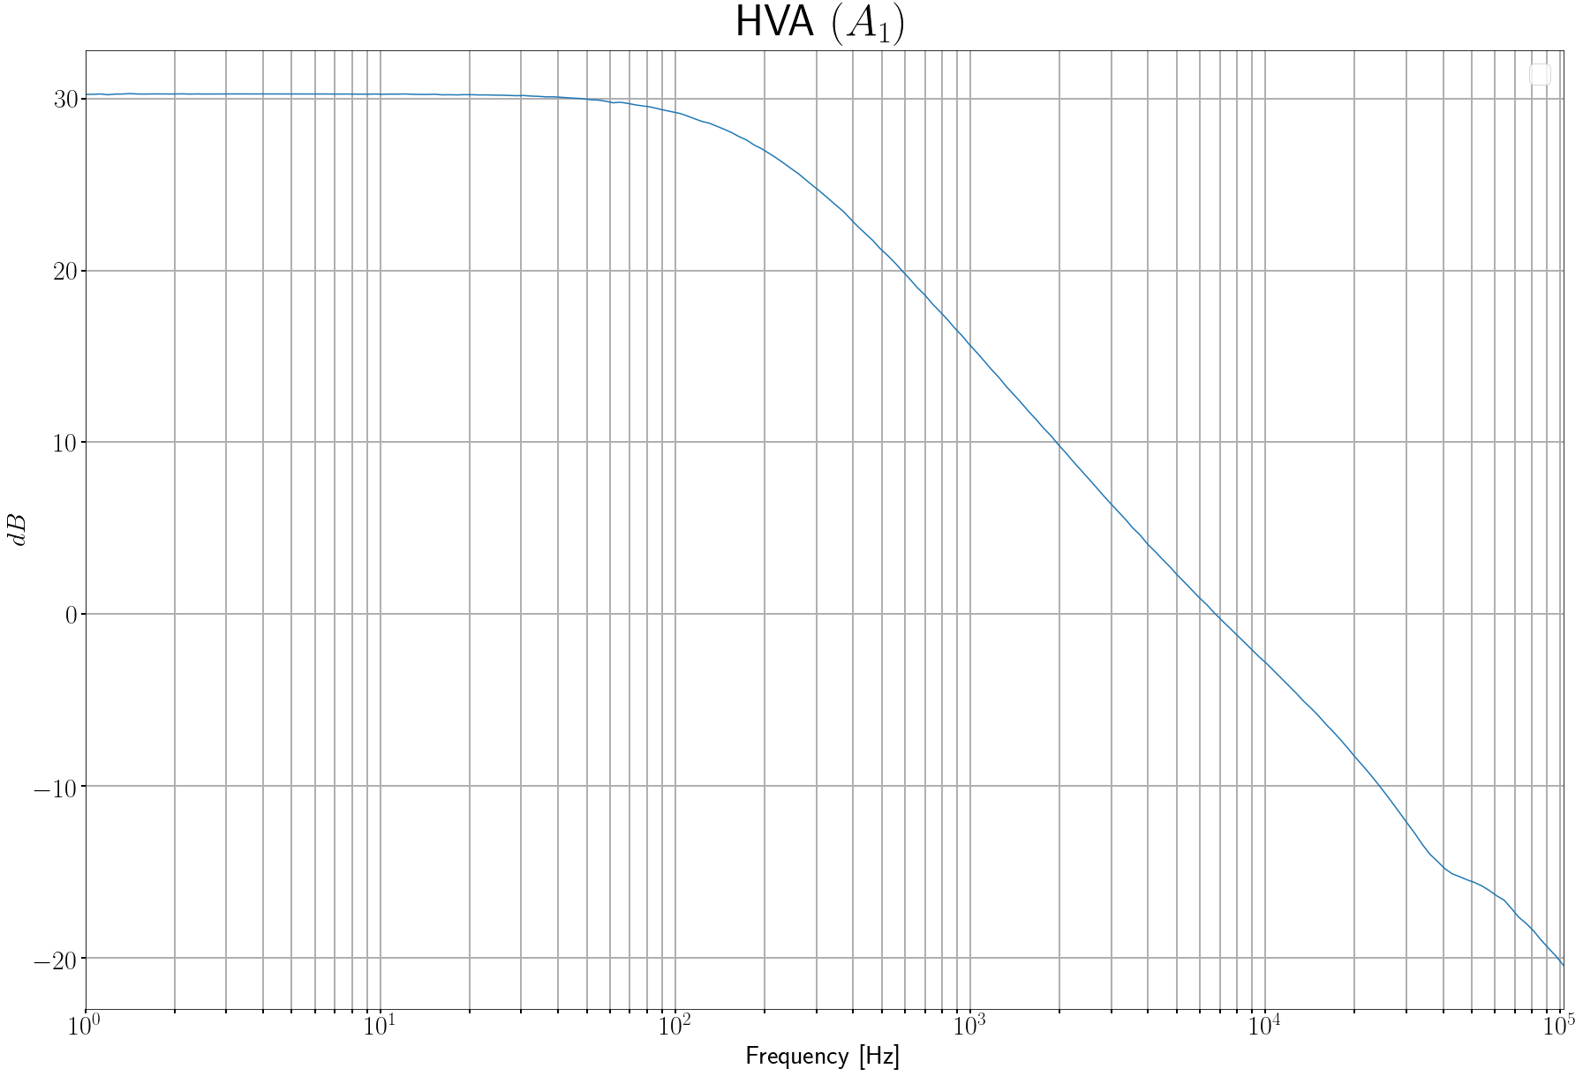

Slide 23
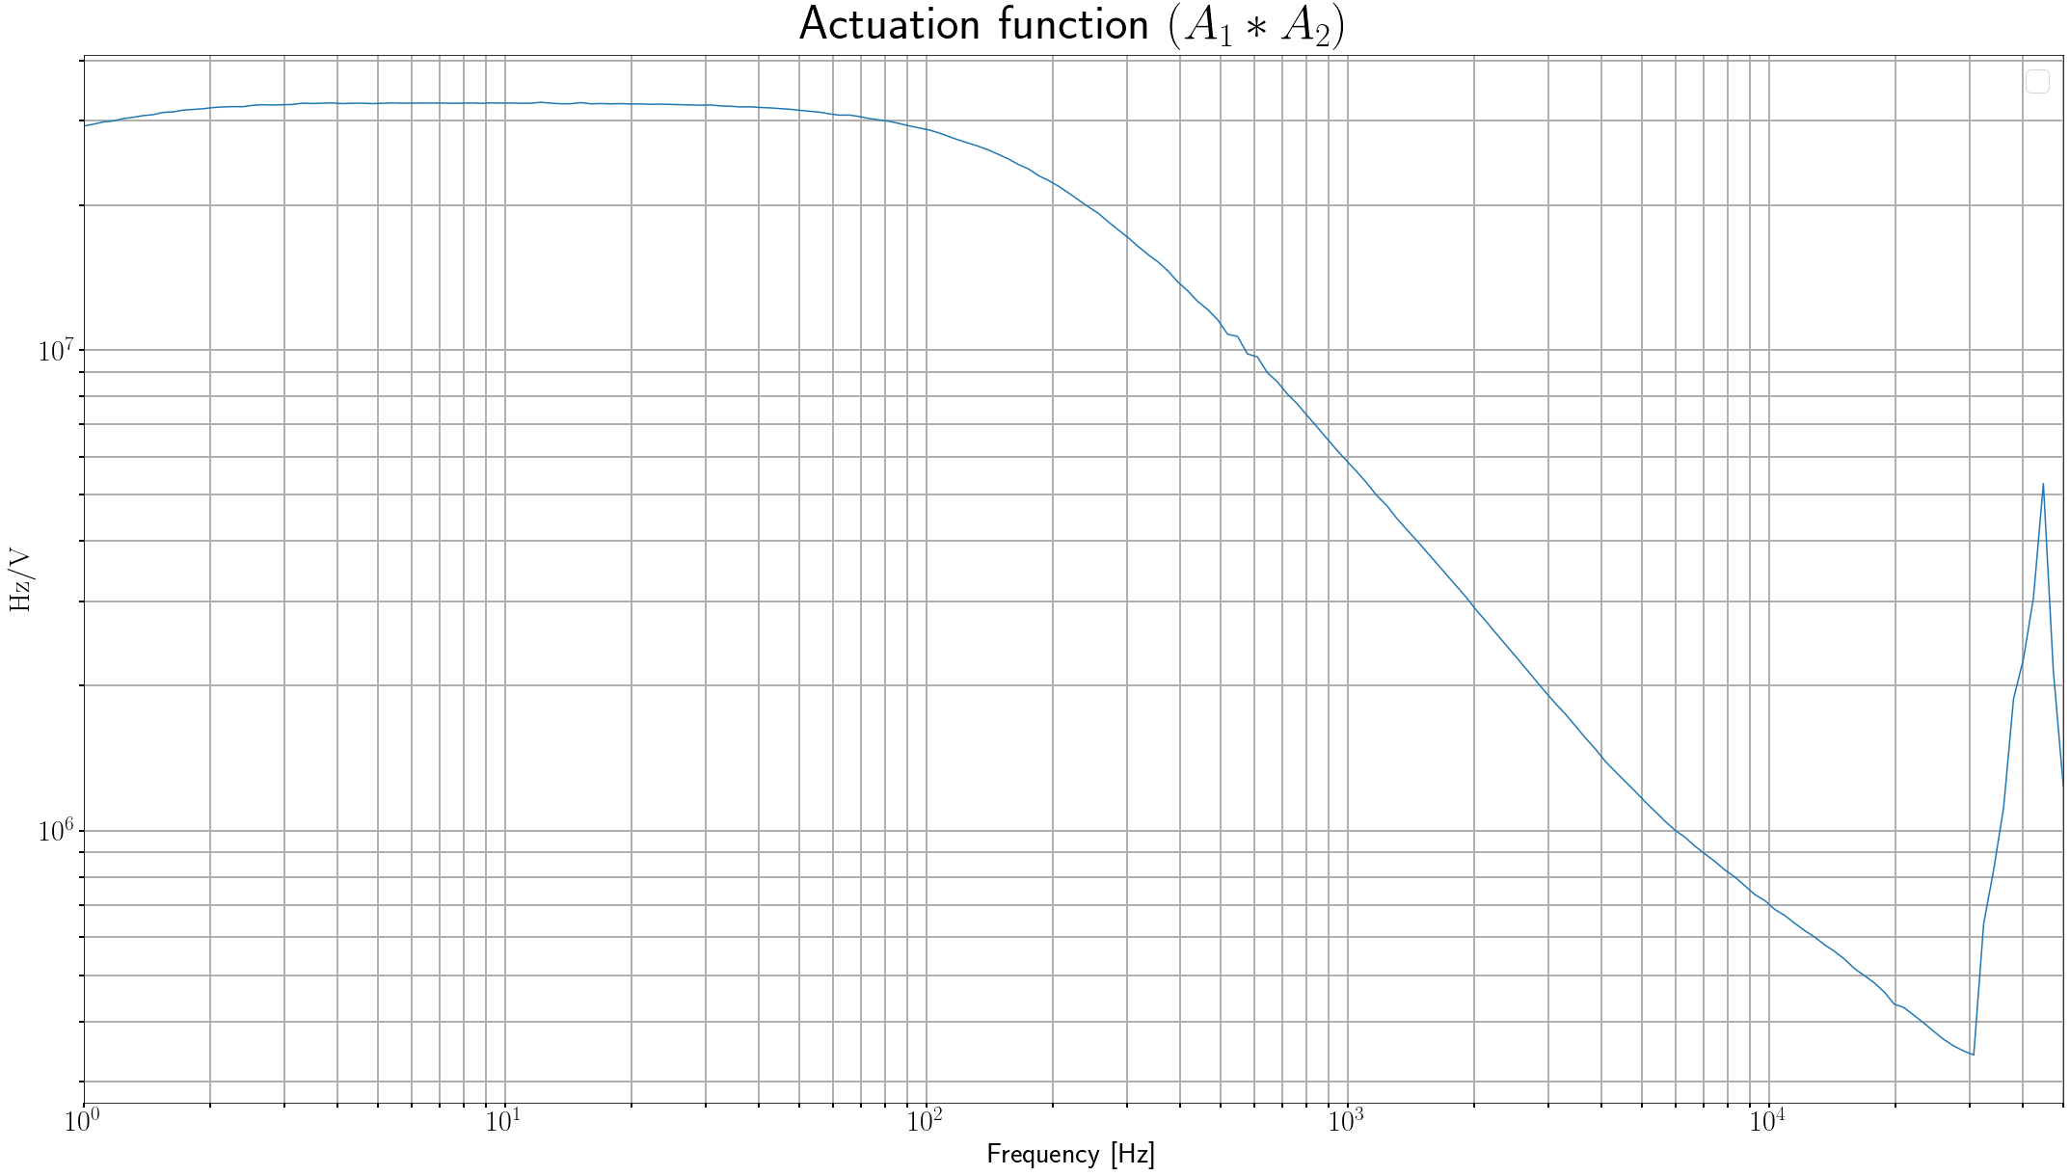
RC lowpass pole at 146 Hz due to HVA resistance
Artifact at 5 kHz due to HVA bypass crossover
Notes:
RC low pass 100 Hz due to HVA amplifier resistance
@ 5kHz there is a switch off to the passive components
(SUGWG elog 412) https://sugwg-alog.phy.syr.edu/aLOG/index.php?callRep=412

Slide 24
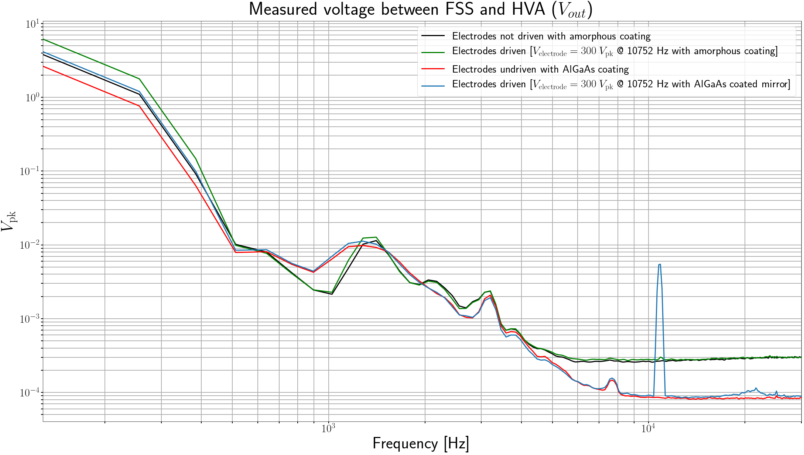

Slide 25
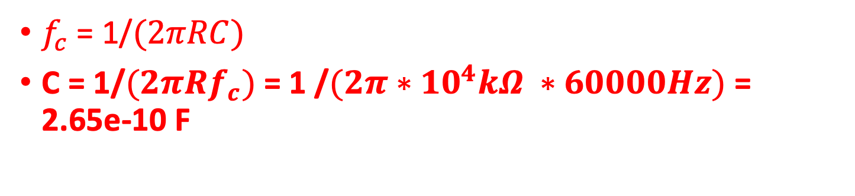
Pole @ 60 kHz
$f_{c}$= 1/$(2πRC)$
C = 1/$(2πRf_{c})$ = 1 /$(2π∗{10}^{4}kΩ ∗60000Hz)$ = 2.65e-10 F

Slide 26
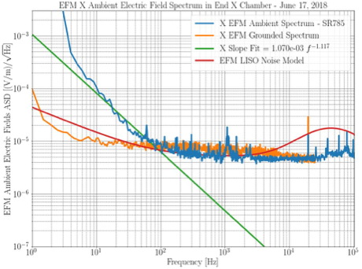
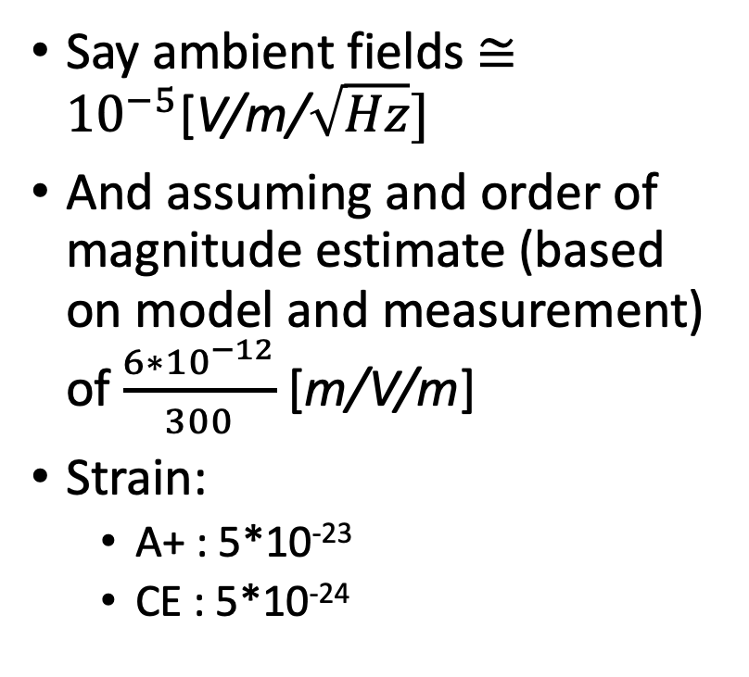
LHO X-end Electric Field meter noise ASD
Say ambient fields $≅{10}^{−5}$[V/m/$\sqrt{Hz}]$
And assuming and order of magnitude estimate (based on model and measurement) of $\frac{6∗{10}^{−12}}{300}$ [m/V/m]
Strain:
A+ : 5*10⁻²³
CE : 5*10⁻²⁴
Credit : Craig Cahillane

